Slide 1
Peer-to-Peer Messaging (using python)
By Andrew Koenig and Connor Seamon

Slide 2
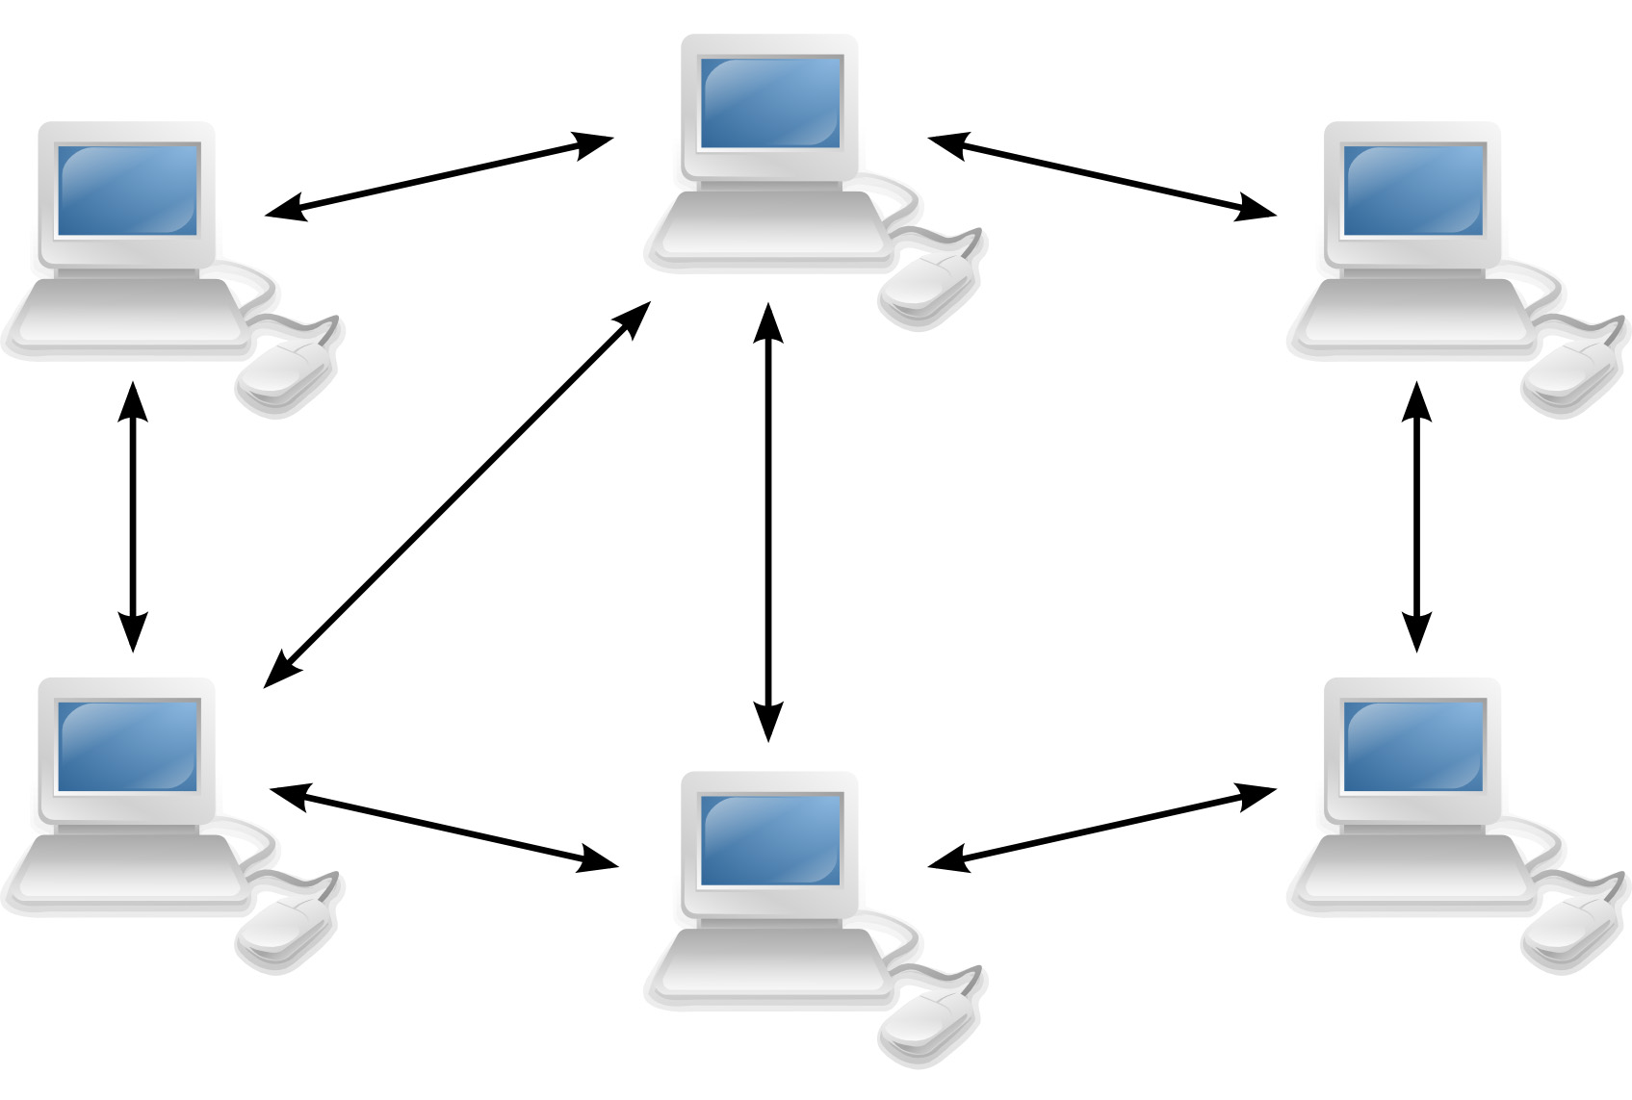
What is peer-to-peer messaging
Communication model where devices(peers) communicate directly with each other without the need for a central server.
In P2P, each device is both a sender and a receiver, able to initiate communication and respond to request from other devices without relying on a central authority.

Slide 3
How p2p works
It starts with Peer Discovery
Peers need to find each other on the network. This can be achieved through a few methods, such as hosting the connection, or connecting to the host
Then the connection establishment
Once peers discover each other, they need to establish a connection. This involves exchanging information such as IP addresses and port numbers to facilitate direct communication.
Data exchange
peers can now exchange data directly, and depending on the application used or protocol can send text, files, ect.

Slide 4

Import statements explained
Import socket : Is a statement that allows you to use the functionality provided by the socket module. The socket module provides a set of methods and classes that allow you to create and work with sockets, which are endpoints for sending or receiving data across a computer network.
Import threading : Is a statement that allows you to use the functionality provided by the threading module. The threading module enables you to create and work with threads, which are smaller units of a program that can run concurrently.
Import sys : Is a statement that allows you to access functionality provided by the sys module. The sys module proves access to some variables used or maintained by python as well as function that interact with the interpreter

Slide 5
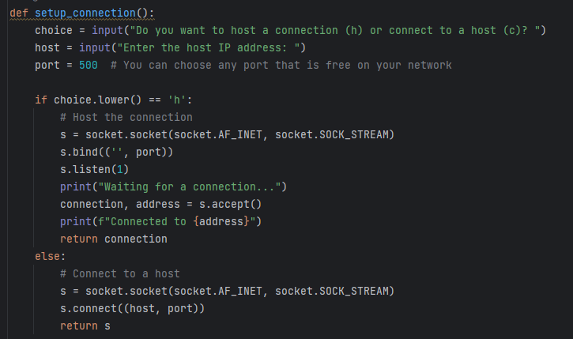
Code explanation

Slide 6
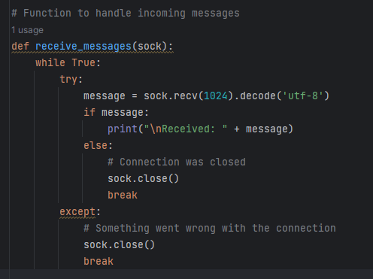
Code explanation cont.
The recieve_messages function is responsible for receiving incoming messages on the socket and decoding them using utf-8 encoding.

Slide 7
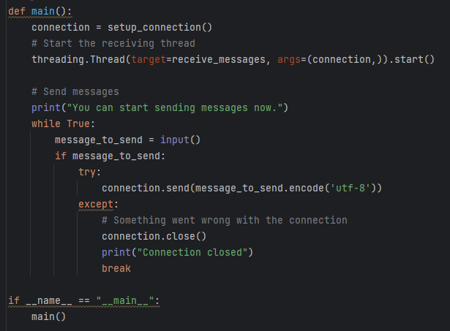
Code explanation cont.
The main function is responsible for calling the other functions, as well as creating the background thread to listen for incoming messages on the created socket.

